Slide 1
Mini Project 5
Silvia hua

Slide 2
Problem
How to capture the nuances of language when automating text classification?

Slide 3
Approach
Data prep
Lemmatize
Feature engineering
GridSearchCV
LogisticRegression vs. SVC vs. XGBoost vs. RandomForestClassifier
Evaluate model performance
GridSearchCV
Remove punctuation
Remove stop words except 5Ws, ‘how’, and ‘not’
Random Forest Classifier
GridSearchCV
Random Forest
SelectKBest
Change train-test Split
SelectKBest vs. PCA
Evaluate model performance
Select Random Forest Classifier

Slide 4
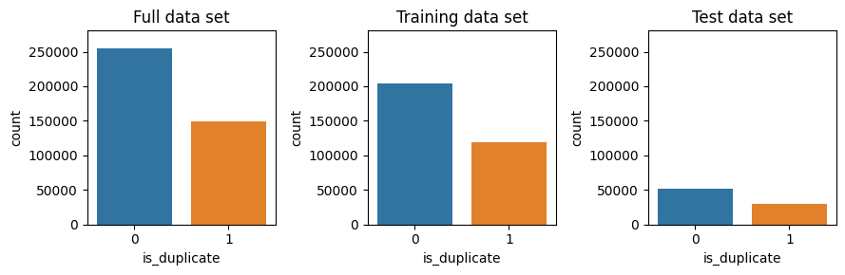
Data Exploration

Slide 5
Data Exploration
Duplicate
Not Duplicate
What is the best way to remove super glue from metal?
How do you dissolve super glue residue from metal?
What are the health benefits of calamansi juice?
What are the health benefits of orange juice?

Slide 6
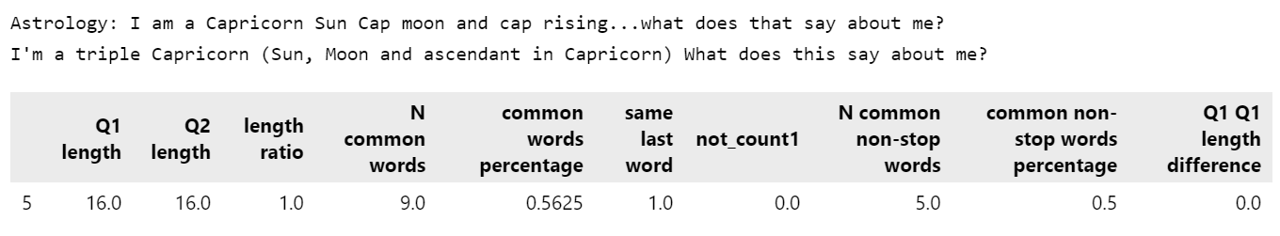
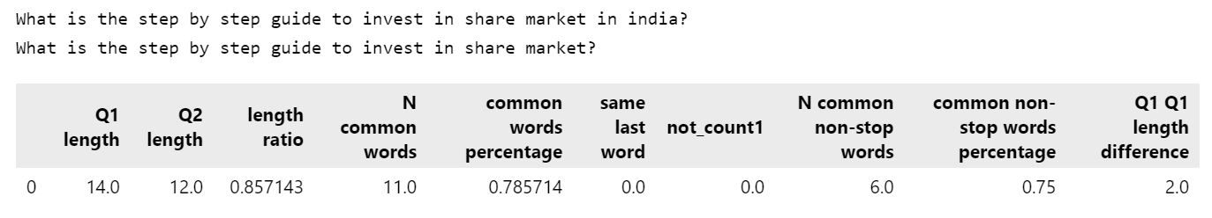
Feature engineering
Sharma, L., Graesser, L., Nangia, N., & Evci, U. (2019). Natural language understanding with the quora question pairs dataset. arXiv preprint arXiv:1907.01041.

Slide 7
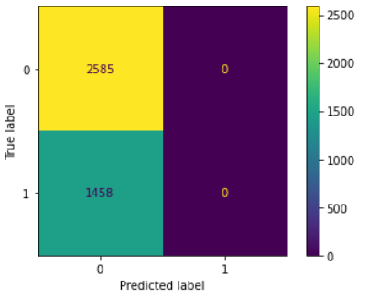
Initial Results XGBClassifier
 | Test data | Training data | Difference
Accuracy: | 63.94% | 63.08% | 0.86%
Recall: | 0.00% | 0.00% | -0.00%
Precision: | 0.00% | 75.00% | -75.00%
F1: | 0.00% | 0.01% | -0.01%

Slide 8
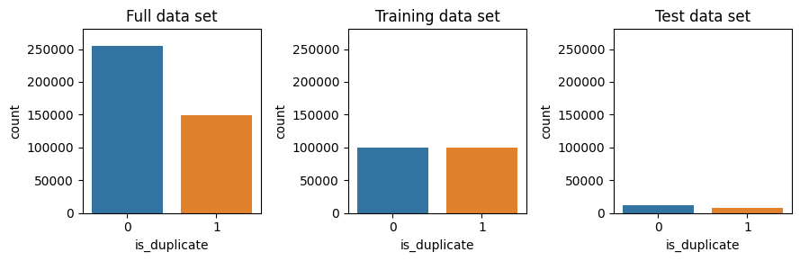
Revised Train-Test Split
Original Train-Test Split
Balanced Train-Test Split (n=20,000)

Slide 9
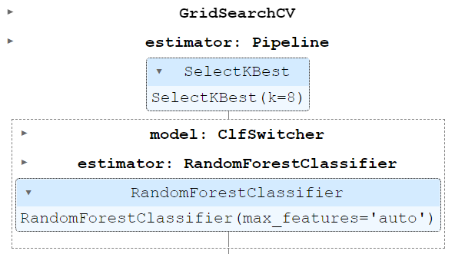
Best Results Random Forest
Balanced Train Set
GridSearchCV `scoring=f1`
Notes:
class_weight='balanced’
min_samples_leaf=5
n_estimators=150

Slide 10
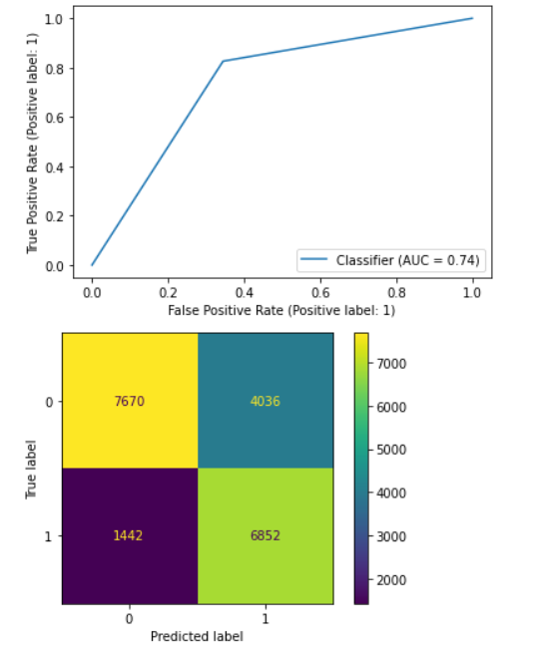
Best Results Random Forest
 | Test data | Training data | Difference
Accuracy: | 72.61% | 77.14% | -4.53%
Recall: | 82.61% | 85.53% | -2.92%
Precision: | 62.93% | 73.24% | -10.31%
F1: | 71.44% | 78.91% | -7.47%
AUC: | 74.07% | 77.14% | -3.07%

Slide 11
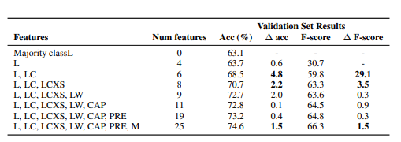
Comparison with the Published results
Table 8: Effects of different hand engineered features on tree based model performance. The results are the average of the results from a decision tree, Random Forest, and gradient boosted machine
Notes:
Table 8: Effects of different hand engineered features on tree based model performance. The results are the average of the results from a decision tree, Random Forest, and gradient boosted machine”

Slide 12
Challenges
Many ways to do data preparation and feature engineering
Large data set and non-vectorized raw data
Different package versions on Colab vs. on local machine
Unsure how to export ROC-AUC plot or confusion matrix display
Not sure how to determine the selected features from SelectKBest due to GridSearchCV

Slide 13
Conclusion & Possible Next Steps
Try different models and feature engineering: word embeddings, Sequential model with embedding layer
Use `.predict_proba()` method to improve model predictions
Change code to speed up preprocessing

